Slide 1

Solution to Final Group Project on Authentication & Authorization
PRESENTED BY:
HABEEB OMOTUNDE
SETH NANA KWAME APPIAH-KUBI
HETVI MANISHBARI BAVARVA

Slide 2
OBJECTIVES OF THE PROJECT
Demonstrating Authentication and Authorization in securing user data and enforcing confidentiality via Contact App.
The three security groups include:
A Registered User,
Manager
Admin

Slide 3
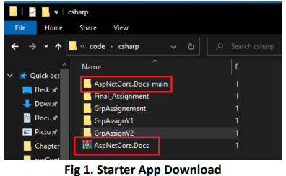
Creating an ASP.NET Core web app with user data protected by authorization
Steps taken by group to execute the solution 1.
Download the starter app from https://codeload.github.com/dotnet/AspNetCore.Docs/zip/main and unzip the AspNetCore.Docs-main.zip file.

Slide 4
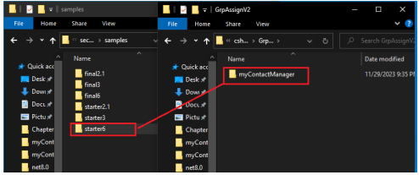
STEP 2
Navigate to the samples directory “.\AspNetCore.Docs-main\AspNetCore.Docsmain\aspnetcore\security\authorization\secure-data\samples” where the starter app is located, copy starter6 folder to the desired directory and rename folder to myContactManager.

Slide 5
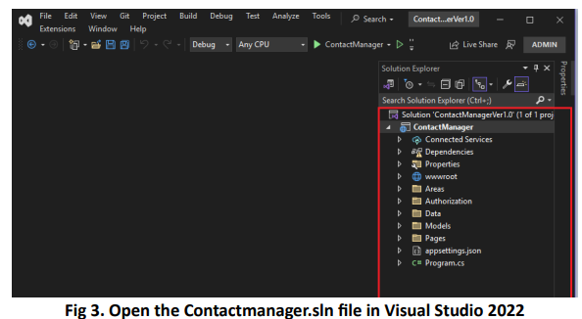
Open Visual Studio 2022 and load the Contact Manager solution, “filename.sln”
Important configurations to setup while following the guide:
a. Install all recommended packages using NuGet Package manager such as:
i. Microsoft.EntityFrameworkCore.SqlServer
ii. Microsoft.EntityFrameworkCore.Tools
iii. Microsoft.AspNetCore.Identity.EntityFrameworkCore
iv. Microsoft.AspNetCore.Authentication.JwtBearer
Note: The packages are pre-installed in the Starter app hence reinstallation is unnecessary

Slide 6
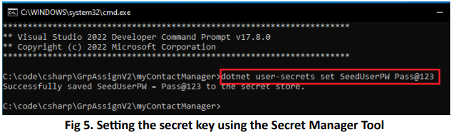
Set the necessary parameters in appsettings.json to point to the appropriate SQLServer and provide the database name.
The starter app enforces strict security policies therefore, the Secret parameter is configured using Visual Studio Secret Manager Tool which is accessed using the Developer Command Prompt under “Tools > command line” menu in Visual Studio 2022. This contrasts with the usual practice of placing the secret key in plain text which could lead to breach of security and unauthorized access to confidential data.
In the Contact manager App, the secret key is stored as “SeedUserPW”. This is configured using the command in Fig 5 below:

Slide 7
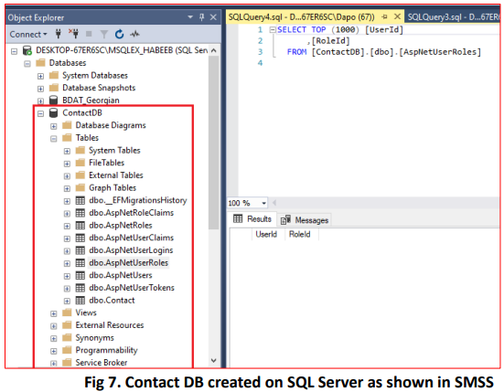
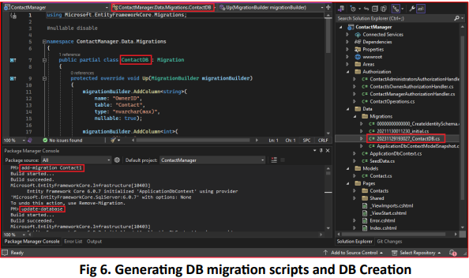
Set up database using the Package Manager console
The database, ContactDB, is created after running the commands in Fig 6 and this can be seen in SQL Server Management Studio in Fig 7.
To enforce authorization on the contact data saved in the Contact DB, each contact record is associated with an owner (UserID on AspNetUsers table) by modifying the Contact model, i.e.
// user ID from AspNetUser table.
public string? OwnerID { get; set; }
Each contact has a status which could either be Submitted, Approved or Rejected.

Slide 8
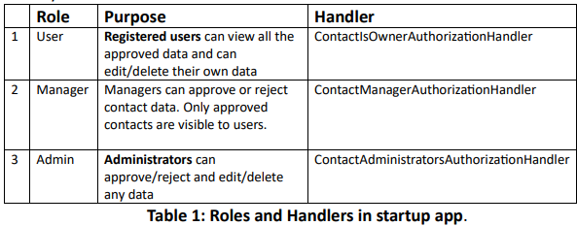
Role-Based Authorization by adding Role services
Next, enable Role-Based Authorization by adding Role services to each identity using the AddRoles() methodof the IdentityBuilder class. This is because when an identity is created it may belong to one or more roles. The starter app has 3 roles namely:

Slide 9
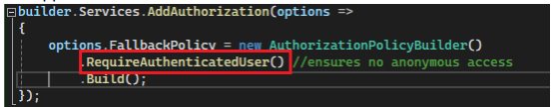
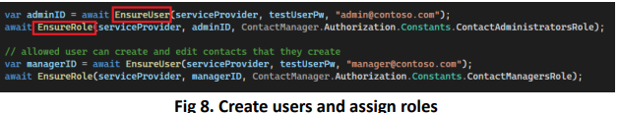
Fallback authorization policy
Set the fallback authorization policy to require users to be authenticated, therefore no anonymous access except for pages or controllers with authorization attribute [AllowAnonymous]. This will make sure any user who intends to access the app must be authenticated.
Configure the test accounts in the SeedData class. This class creates two accounts using it’s Initialize method and also assigns each user to a role by calling the respective methods.
To create the accounts correctly, a strong password must be set in step 4f else the exception below will be thrown: “Unhandled exception. System.Exception: The testUserPw password was probably not strong enough!”

Slide 10
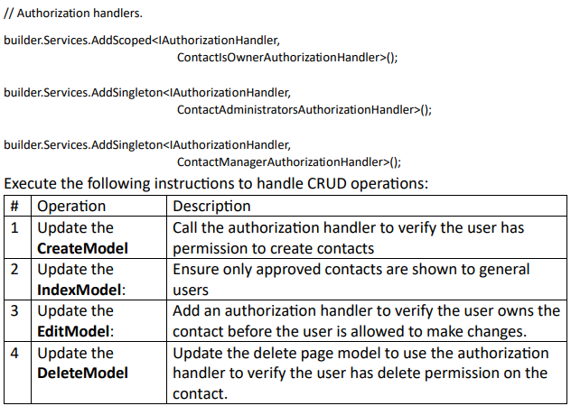
Execute the following instructions to handle CRUD operations

Slide 11
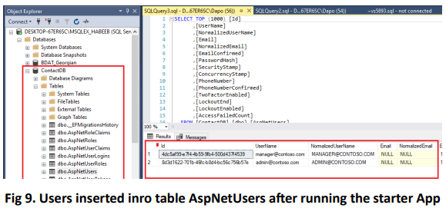
Build & run the completed application
a. Ensure a strong password is set with the Secret Manager tool
b. Before starting the application, ensure the Microsoft SQL server is running.
c. Note the two user records created and inserted into the dbo.AspNetUsers table on ContactDB. These are the manager and administrator users.

Slide 12
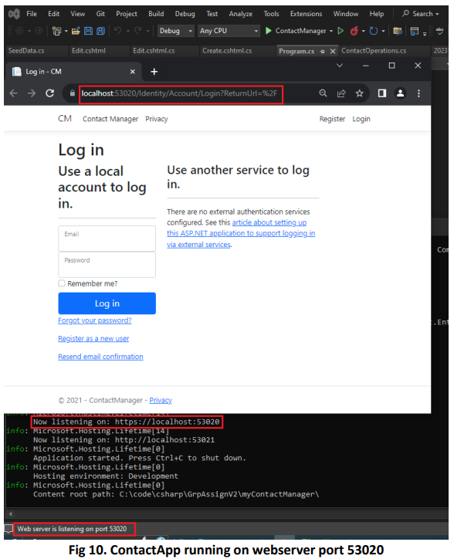
Login in - CM

Slide 13
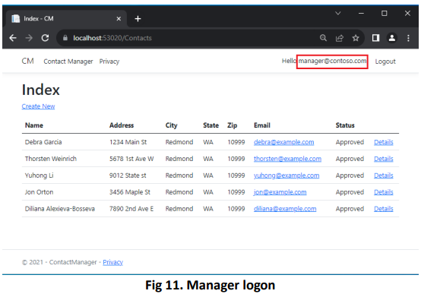
Users using the SeedUserPW configuration
Login with either of these users using the SeedUserPW configured with the secret tools manager. The Figure below shows a login with manager.
A manager can approve/reject contact data. The Details view shows Approve and Reject buttons. Note that managers can not edit or delete contact data.

Slide 14
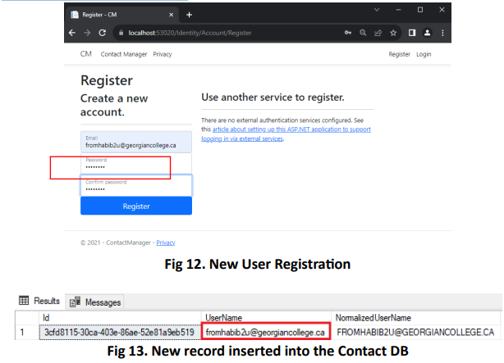
New User Scenario
A new user (fromhabib2u@georgiancollege.ca) will be registered and record will be inserted into the database.

Slide 15
Manager’s console requesting approval or rejection
The user will create a contact ,as highlighted in Fig 14, which will appear on manager’s console requesting approval or rejection. Also, only the newly created contact displays edit, details and delete links.
Manager can view detail of submitted contact & either approve or reject it. In this case, contact is approved.
When the new user views it as seen in Fig 16, status will change from Submitted Approved.
Admin will be able to review approval, view details, edit or delete contact to demonstrate their different access rights. In this case he decides to override the manager’s approval and reject the contact.

Slide 16
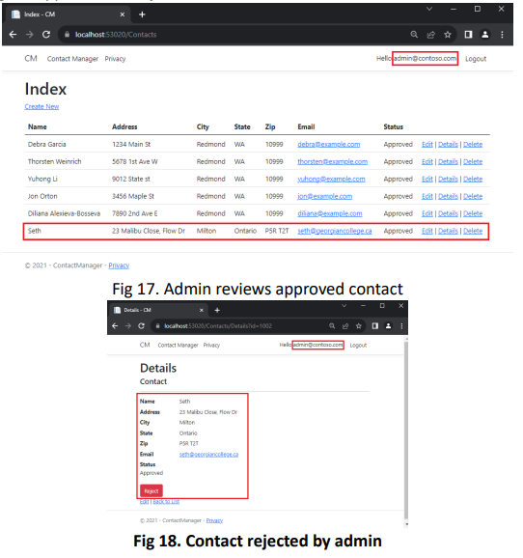
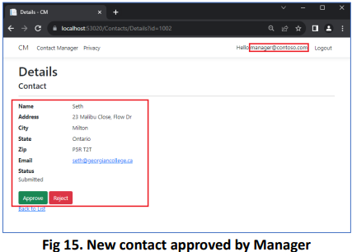
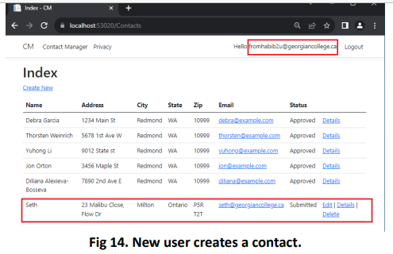
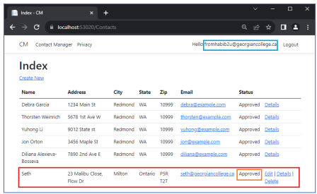
Pictorial Illustrations

Slide 17
Conclusion
The sample Contact App has been used in demonstrating Authentication and authorization in securing user data and enforcing confidentiality. As a recap, the starter app has 3 security groups namely, a registered user, manager and admin. Their respective access right are summarized below:
Registered users can view all the approved data and can edit/delete their own data.
Managers can approve or reject contact data. Only approved contacts are visible to users.
Administrators can approve/reject and edit/delete any data.

